Slide 1

Learning Objectives:
I can understand what a digital footprint is and its implications.
I can analyse the potential long-term impact of one's online activity.
I can develop strategies to manage and minimise my digital footprint.
Success Criteria:
All: Explain what a digital footprint is and why it matters.
Most: Discuss the impact of a digital footprint on privacy and how to manage it.
Some: Analyse case studies related to digital footprints and recommend strategies for minimising online risks.

Slide 2

What is a Digital Footprint?
Prompt: “What do you think a digital footprint is?”
Watch a short video clip or infographic on the concept of a digital footprint.
Discussion:
How many times have you posted something online?
Have you ever thought about where that information goes or who might see it?

Slide 3
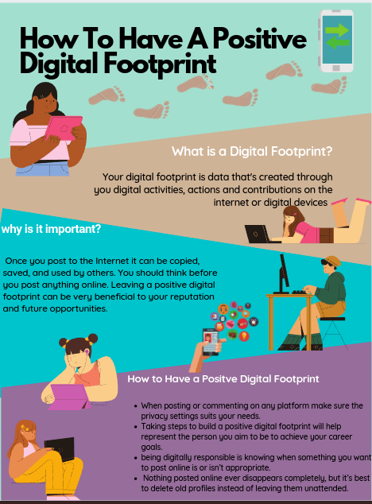
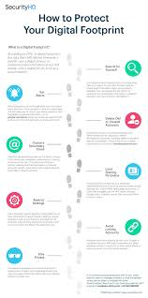
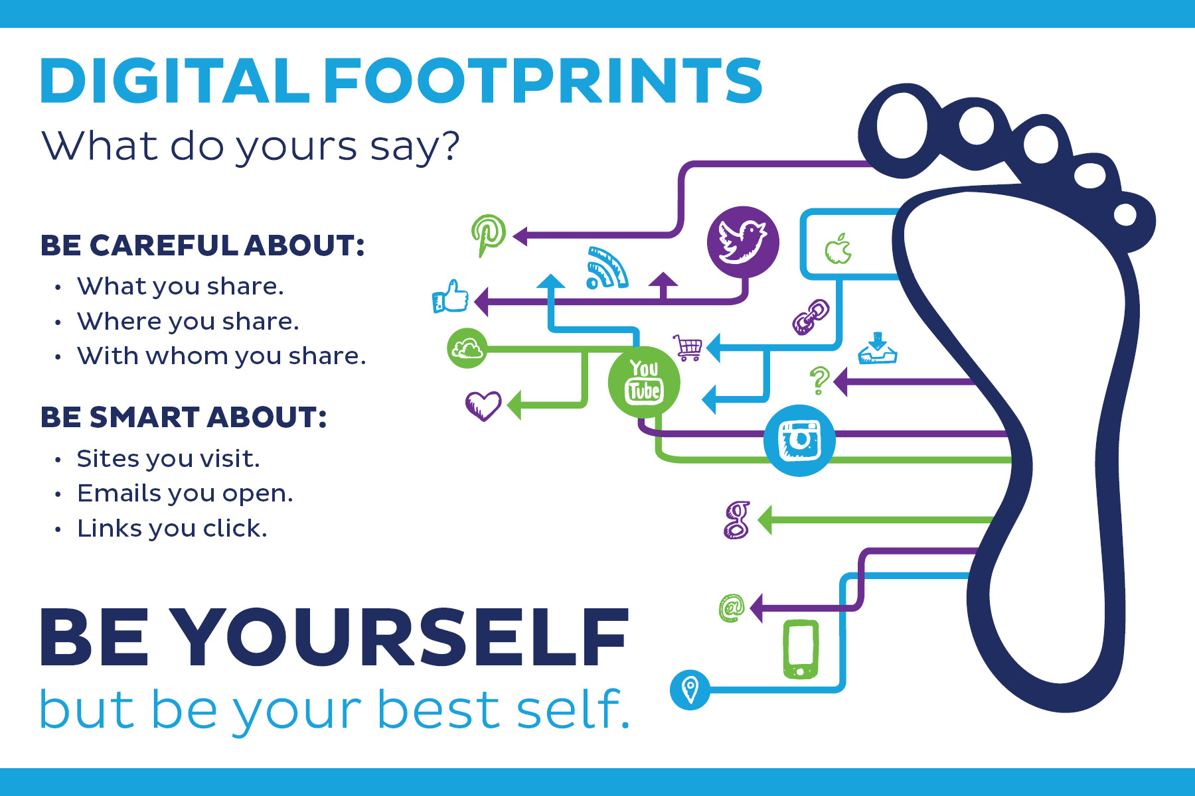

Slide 4
What is a Digital Footprint?
Every action online leaves a trace – comments, posts, purchases, social media activity.
Can be searched, copied, shared.
Impacts personal and professional life positively and negatively.

Slide 5
Main Activity – Investigating Public Figures’ Digital Footprints
Scenario:
You are digital investigators.
Analyse the online presence of public figures (e.g., celebrities, athletes, politicians, influencers).
Task:
Guiding Questions:
What information is publicly available about this person (social media, news, videos)?
How has their digital footprint positively impacted their career?
Have there been any negative consequences (scandals, setbacks)?

Slide 6

Group Task
Digital Footprint Analysis Report:
Identify key elements of their digital footprint.
List positive and negative impacts.
What can we learn from their online activity?
How could they have managed their digital footprint better?

Slide 7
Example Questions to Guide Your Analysis
What kind of information did they share publicly?
How did their posts, comments, or interactions shape their public perception?
Did they experience any controversy or setbacks due to their online actions?
What strategies could they have used to manage their digital footprint more effectively?

Slide 8
Plenary – Reflection and Connection to Your Own Behaviour
Discussion:
What can we learn from these public figures about managing our digital footprints?
How can you apply these lessons to your own online presence?

Slide 9
Self-Assessment
All: Explain what a digital footprint is and why it matters.
Most: Discuss the impact of a digital footprint on privacy and how to manage it.
Some: Analyse case studies related to digital footprints and recommend strategies for minimising online risks.

